Slide 1

Note: The data and information in this document is reflective of a hypothetical situation and client. This document is to be used for KPMG Virtual Internship purposes only.
Sprocket Central Pty Ltd
Data analytics approach

Slide 2
Note: The data and information in this document is reflective of a hypothetical situation and client. This document is to be used for KPMG Virtual Internship purposes only.
Agenda
Introduction
Data Exploration
Model Development
Interpretation

Slide 3
Note: The data and information in this document is reflective of a hypothetical situation and client. This document is to be used for KPMG Virtual Internship purposes only.
Introduction
Data exploration of both new customer and transactional data is presented with a major focus on:
AGE
GENDER
STATE OF THE CUSTOMER
JOB INDUSTRY OF CUSTOMER
Wealth SEGMENTATION
MOST BOUGHT PRODUCT LINE
PROFIT GENERATED

Slide 4
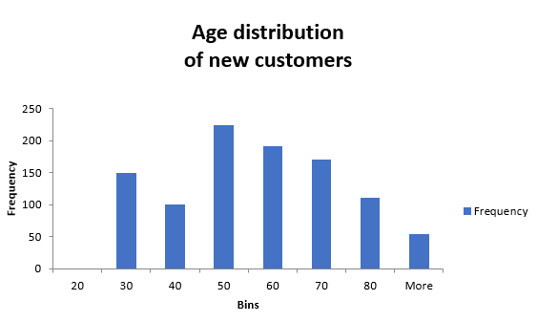
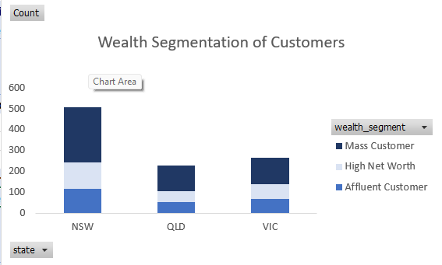
Note: The data and information in this document is reflective of a hypothetical situation and client. This document is to be used for KPMG Virtual Internship purposes only.
DATA EXPLORATION OF NEW CUSTOMERS
More customers ages are between 21-45 years
More customers belong to New south wale
Most are Mass customer

Slide 5
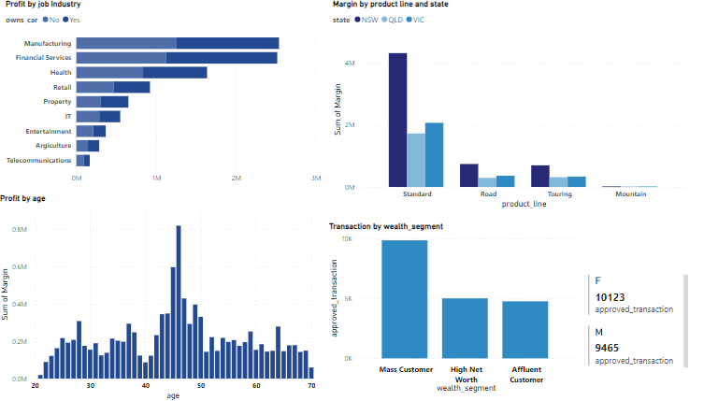
Note: The data and information in this document is reflective of a hypothetical situation and client. This document is to be used for KPMG Virtual Internship purposes only.
MODEL DEVELOPMENT
The following generate more profit margin:
Manufacturing and financial service
People from age 40-50
Females did more transactions
Mass customers from the wealth segment
Standard product from the product line is bought often
Place any supporting images, graphs, data or extra text here.

Slide 6

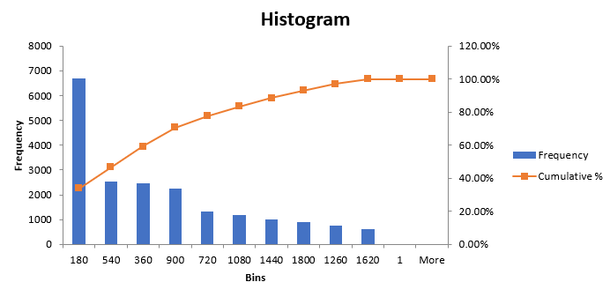
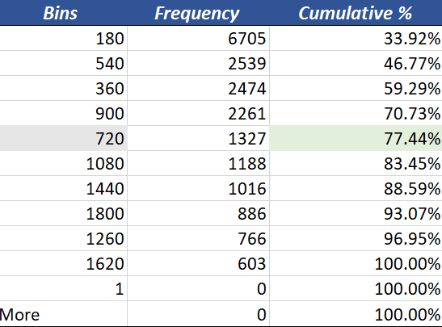
Pareto Analysis
80 % of profit comes from the customers with the profit range of 1$-720$. Hence High priority customers

Slide 7
Note: The data and information in this document is reflective of a hypothetical situation and client. This document is to be used for KPMG Virtual Internship purposes only.
Interpretation
Major Target Audience for the campaign will be:
Females
The Mass customers
Age between 40-50
Living in south Wales
Industry Manufacturing and financial
Product line focus:
Standard product line

Slide 8
Note: The data and information in this document is reflective of a hypothetical situation and client. This document is to be used for KPMG Virtual Internship purposes only.
Appendix

Slide 9
Note: The data and information in this document is reflective of a hypothetical situation and client. This document is to be used for KPMG Virtual Internship purposes only.
Appendix

